Slide 1
Zoo Manager System
Submitted by:
David Ben Yakov
Kristina Goldin
Stav Ezra

Slide 2
Description
The program is responsible to monitor the animal’s health and needs, documents their feeding and treatments and also adding new animals to the zoo, storing and managing all the relevant data about the zoo animals and showing all the data to the user, by sorting and selecting which data the user in interested in monitoring.
The program also has a sub system that sells tickets to visitors to enter the zoo.
In the sub system, the options are: Selling tickets, making payments, canceling tickets, making zoo entrances, showing purchase and entrance history of all visitors and also adding new visitor files for convenient future purchases.

Slide 3
What is the database for?
In this project, we want to build a database for our JAVA program.
The program is storing a lot of data: purchases, entrances, visitors and employees.
In our application, the data is stored in different data structures that are built in the JAVA language such as lists, sets, maps etc.
A database solution would be perfect for our program, in order to store the large amount of data in a safe, convenient and organized way. Also we want the data to be saved each time we disconnect from the program.
Therefore, in this project we are going to build a database in PostgreSQL server, that is going to help us take this program to a new level of magnitude and complexity.

Slide 4
The entities of our new database are:
Employees, visitors, tickets, entrances, users and animals.
The relationships between entities:
Employees work at the zoo and connect to the program with a username and password.
The employees monitor and document all the zoo animals and also sell tickets to visitors.
The visitors buy tickets and make entrances to the zoo by using the tickets they bought.

Slide 5
Requirements
After logging into the pgAdmin system, you need to enter the password to connect to the "PostgreSQL" server.
To create a new database, press right-click on “databases” and create a new database the give it a name.
To open the query file that creates the database, click on: Databases → Postgres → Query Tool → Open File → CreateDatabaseQueries.sql
Once the file is loaded into the system, you can execute it by clicking on Execute Script (F5) and the database will be created.

Slide 6
Next, open the "Eclipse" development environment, create a new Java project, and perform the following steps:
Copy all the source files from the "zooManagerSystemWithSQLdb.zip" file into the ‘src’ directory of the new project you created in "Eclipse“.
Copy the “postgresql-42.7.3.jar“ file into the project directory.
Right-click on the project folder you created → Build Path → Configure Build Path → Libraries → Classpath → Add External JARs → postgresql-42.7.3.jar → Apply and close.

Slide 7
The class that represents the database of the project is located in the dataBases package.
The class called: jdbc.java.
In the line: conn = DriverManager.getConnection(dbUrl, "postgres", "afeka");
Replace the word “postgres” with the name of the database you opened in pgAdmin.
Replace the word “afeka” with the password you initialized in your PostgreSQL server in pgAdmin.
Finally, refresh the software, and then run the code by clicking the “Run Application” button.

Slide 8
Users
The users of the program are:
the zoo employees – zoo animal keepers, cashiers and managers.
User Permission Management:
The zoo manager is an admin and can perform any action.
Employees have view and edit permissions only.

Slide 9
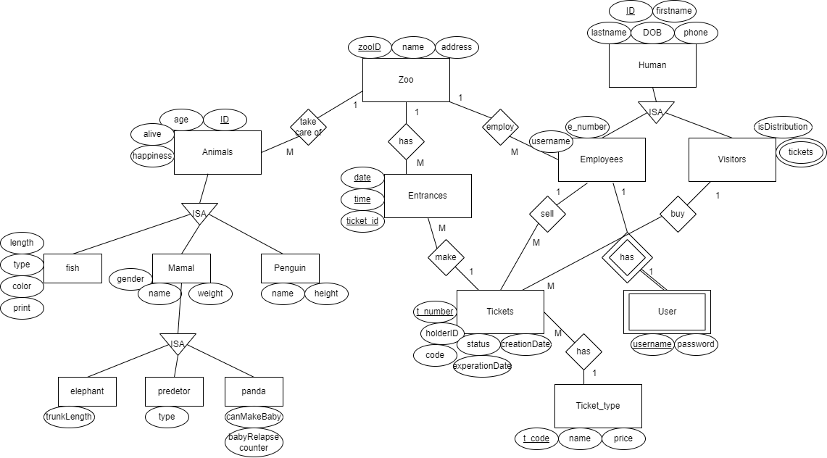
ERD Diagram

Slide 10
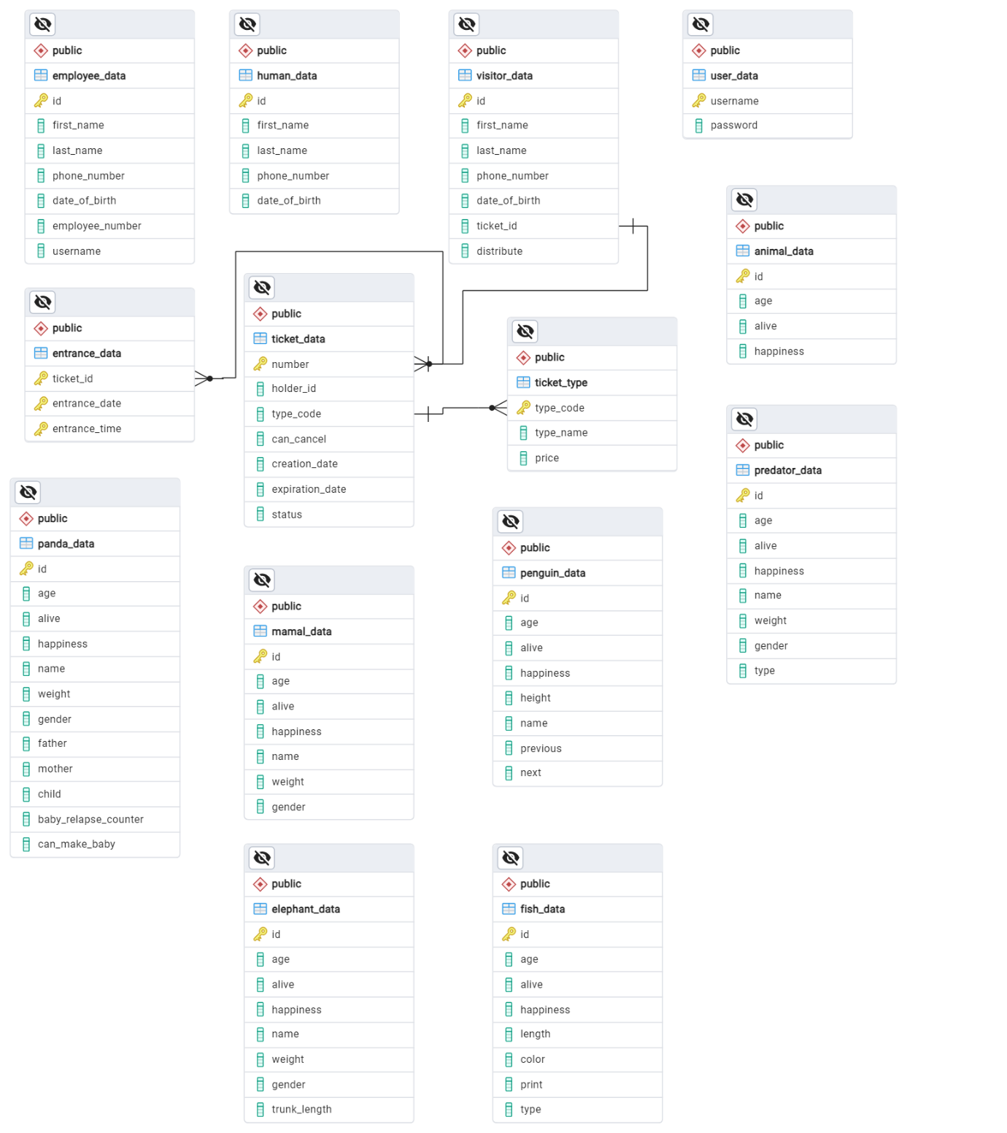
Table Diagram

